Slide 1

Phishing awareness training
Understanding, identifying , and preventing phishing attacks
Prepared by : sneha ramdas lavhe

Slide 2
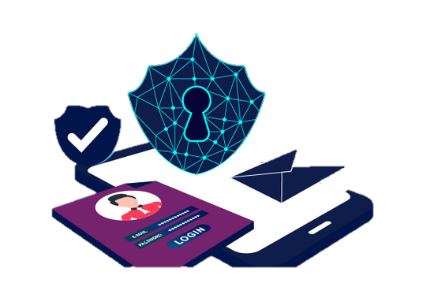
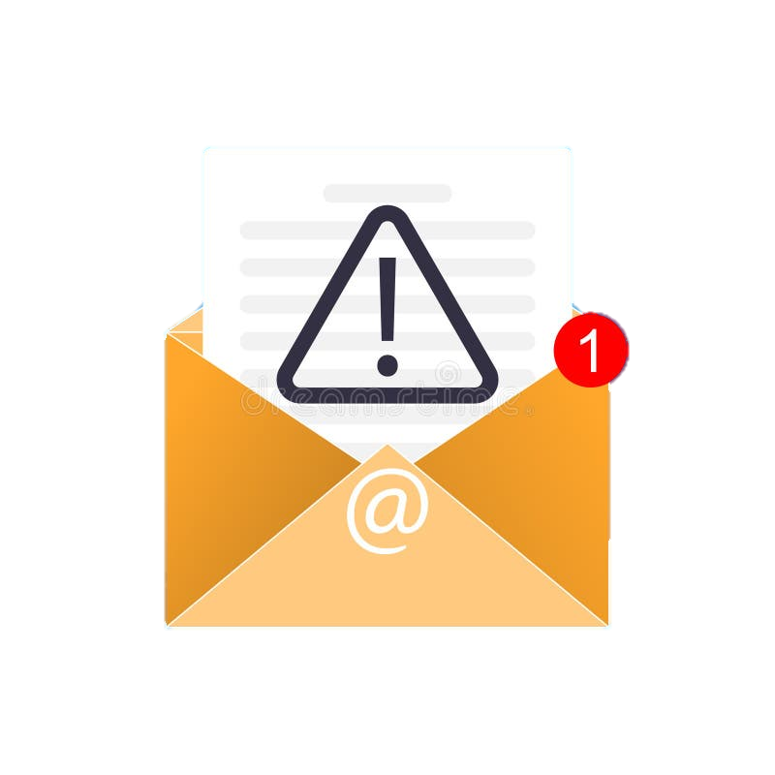
Introduction To Phishing
What is Phishing?
Phishing is a type of Cyber Attack where attackers trick users into revealing sensitive information.
Attackers impersonate trusted organizations or individuals.
Commonly targets:
Login credemtials
Bank Details
Credit/Debit card information
OTPs and Personal Data
Why is Phishing Dangerous
Leads to identity Theft - Financial Loss - Unauthorizes System Access

Slide 3

Objectives Of Phishing Awareness
Training Objectives :
Understand what phishing attacks are
Learn how to recognize phishing emails and websites
Identify social engineering tactics
Follow best practices to avoid phishing
Improve user security awareness

Slide 4
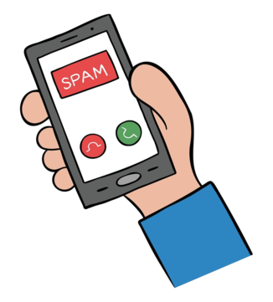
Types Of Phishing Attacks
Common types of Phishing:
Email Phishing :- Fake Emails from banks, Companies
Spear Phishing :- Targeted attacks on specific individuals
Smishing :- Phishing through SMS message
Vishing :- Phishing through phone calls
Website Phishing :- Fake websites mimicking real ones

Slide 5
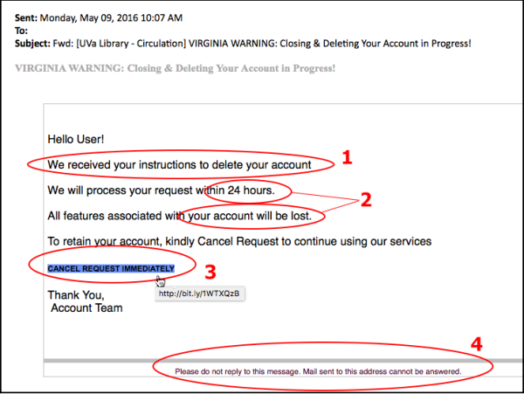
How Phishing Emails Look
Common characteristics of Phishing Emails:
Urgent message like “Account will be blocked”.
Suspicious sender email address.
Grammer and spelling mistakes.
Unknown attachements.
Links asking for immediate action.
Example:
“Click here to verify your account immediately !!”

Slide 6
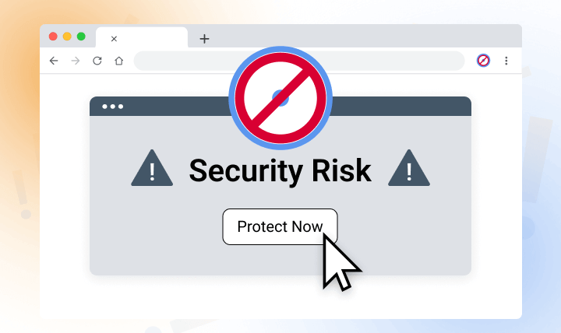
How To Identify Fake Websites
Signs of Fake websites:
URL looks similar but incorrect. -No HTTPS or invalid security certificate.
Poor website design layout - Fake login forms
Too-good-to-be-true offers
Example URLs:
Real : https://www.paytm.com
Fake: https://paytm-secure-login.net

Slide 7
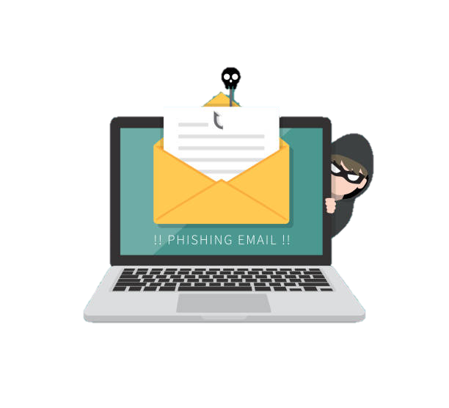

Social Engineering Techniques
Tactics Used by Attackers:
Urgency : “ Immediate action required!”
Fear : “Your account has been compromizes!”
Trust: Pretending to be banks, HR, or admins.
Reward: Lottery or Prize offers.
Authority: Fake emails from seniors or officials.

Slide 8
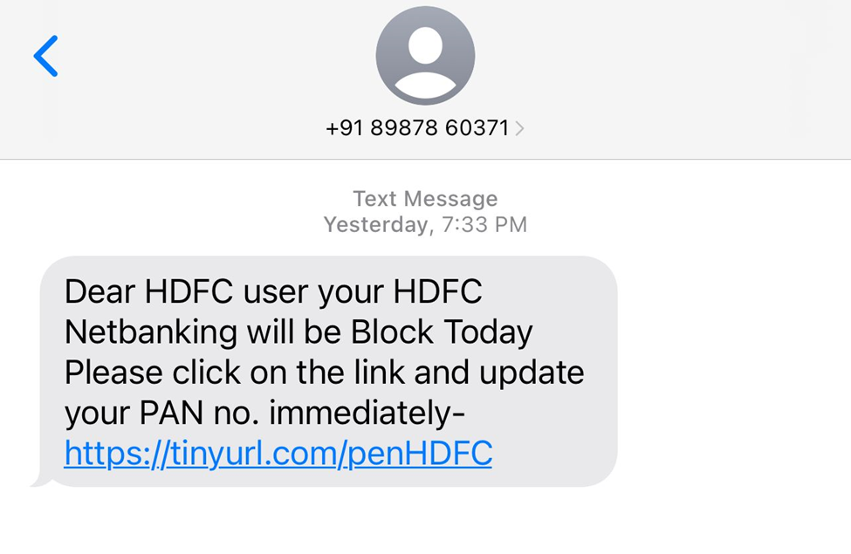
Real-world Phishing Example
Scenario:
User receives an email claiming to be from bank.
Email asks to update KYC details via a link.
Why it is Phishing:
Bank never asks for passwords via email.
Suspicious link - Creates urgency
Correct Action:
Do not click the link - Verify via Official link
Report the email

Slide 9
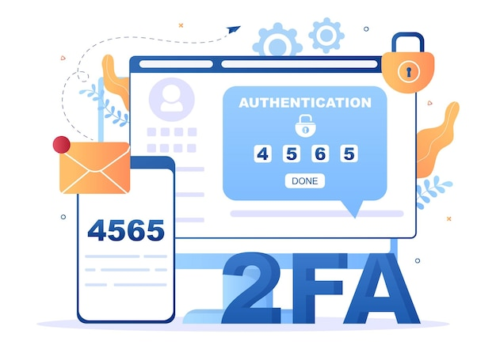
Best Practices To Avoid Phishing
Security Best Practices:
Never Click unknown Links. - Verify sender email address.
Do not share passwords or OTPs. - Use strong & Unique Passwords.
Enable teo-factor authentication(2FA) - Keep software updated.

Slide 10
DO’s & Don’t’s
DO’s
Check URLs carefully.
Report suspicious emails.
Use antivirus firewall.
DON’Ts
Do not share credentials.
Do not trust urgent threats.
Do not download unknown documents.

Slide 11

Interactive Quiz
Q1. What is Phishing?
Network scanning c) Data encryption
Fraudlent attempt to steal information d) Firewall rule
Q2. Which is I Phishing sign?
Official website c) HTTPS enabled
Urgent threatening mesaage d) Known sender

Slide 12

conclusion
Phishing attacks are increasing rapidly
Awareness is the first line of defense.
Users must stay alert and informed
Proper training reduces cyber risks significantly.
Final Message :
Think Before You Click!!

Slide 13
REFERENCES
https://www.cybercrime.gov.in
https://owasp.org
https://www.cisa.gov/phishing

